Slide 1


Fatigue Life Prediction of Aircraft Structures
PO-233 Final Project Aeronautics Institute of Technology Jun/2025
Felipe Gomes
Lennon Falcão
Victor Olegário
Prof. Felipe Verri, Ph.D

Slide 2
table of contents
01
02
03
04
Definitions, motivation and objectives
problem description
Exploratory Data Analysis and ML Techniques
methods
results
Evaluation, Model Selection and Improvements
Final Remarks
CONCLUSIONs

Slide 3
01
PROBLEM DESCRIPTION
Definitions, motivation and objectives

Slide 4
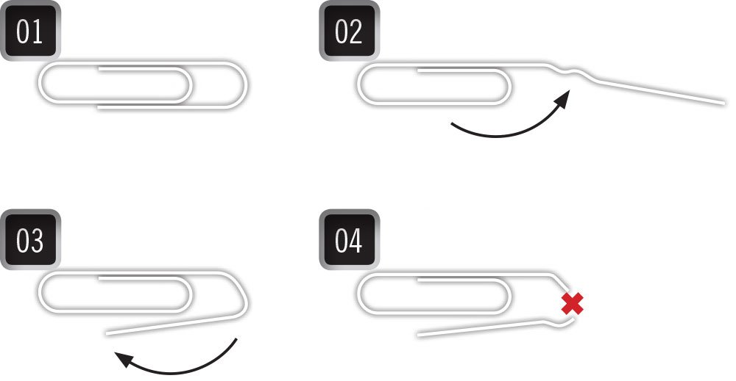
FATIGUE DAMAGE
The fatigue phenomenon is defined as the process of progressive and localized structural damage that occurs when a material is subjected to cyclic loading, generating crack nucleation and propagation.
In general, the crack occurs in regions where there are stress concentrations, where stress can be defined as the internal effort of the material.

Slide 5
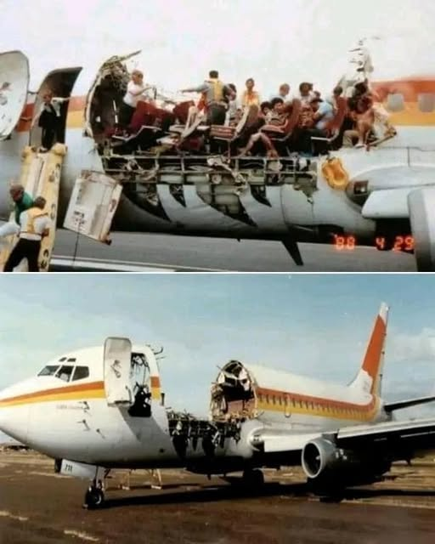
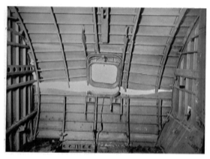
fatigue damage
Aeronautical accidents have proven that this phenomenon can be catastrophic if not properly considered in the aircraft design phase.

Slide 6
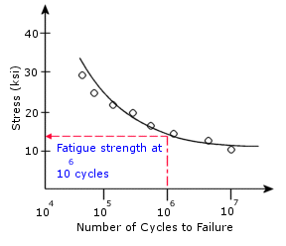
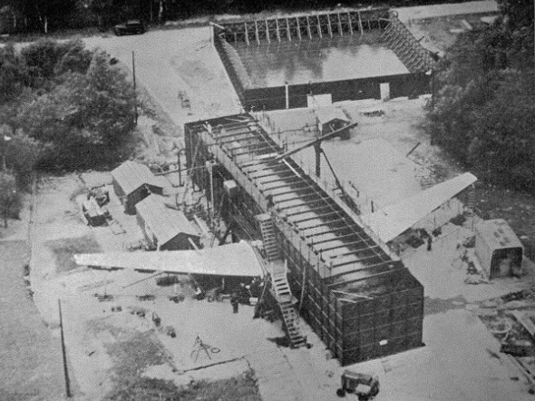
how to deal with it?
Many safety requirements have been developed by regulatory agencies around the world, and this issue is thoroughly addressed in the aeronautical industry through engineering calculations and extensive testing.

Slide 7
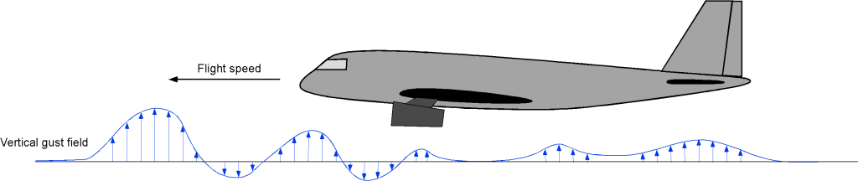
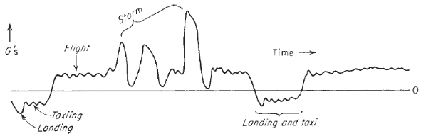
HOW TO PREDICT DAMAGE, IF…
Different conditions

Slide 8
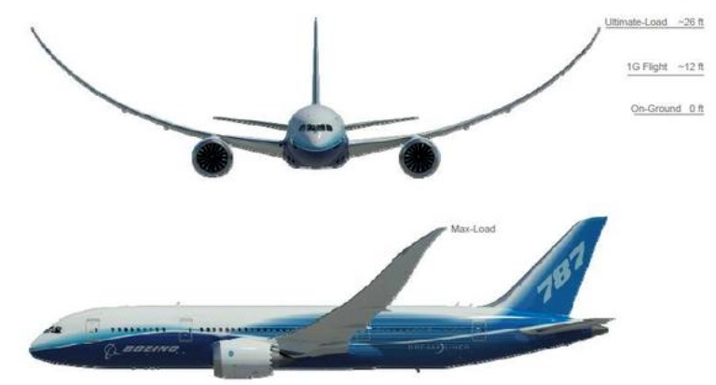
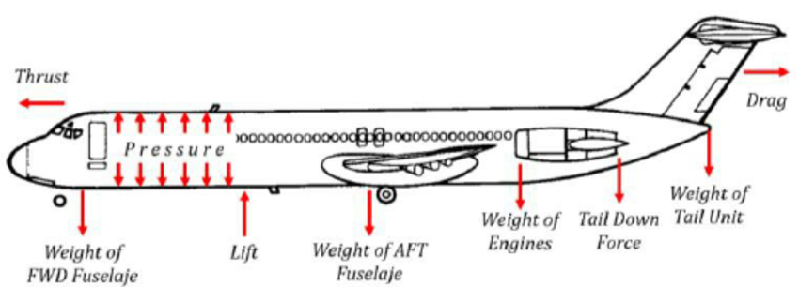
HOW TO PREDICT DAMAGE, if…
Several types of loading

Slide 9
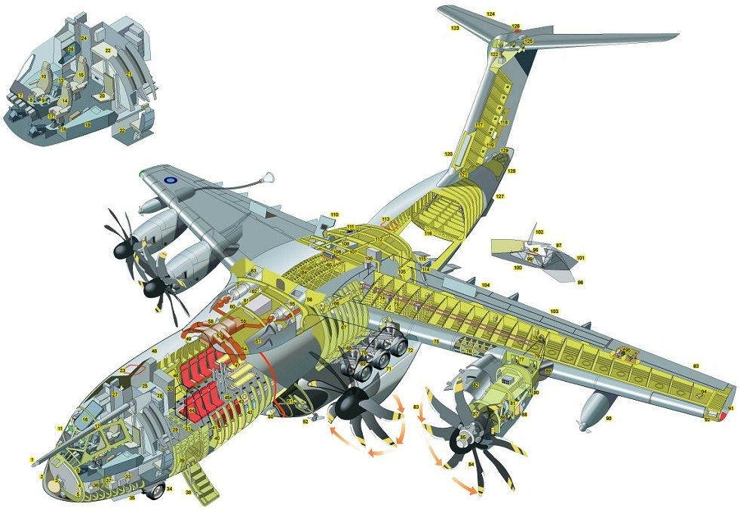
HOW TO PREDICT DAMAGE, if…
Thousands of structural details

Slide 10
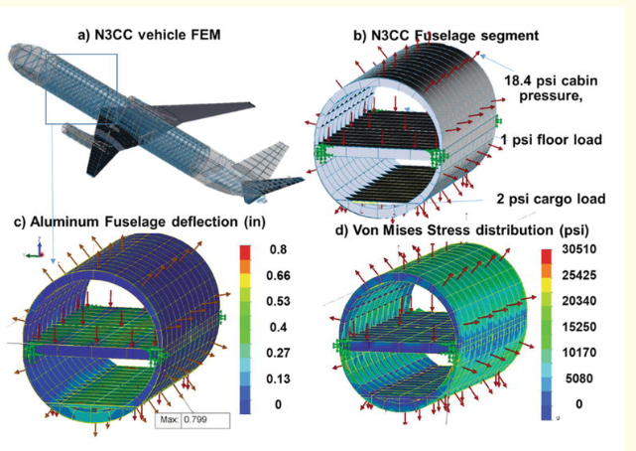

motivation
These variables require the development and application of highly complex models, which are associated with high computational cost and long run times.

Slide 11

objective
These variables require the development and application of highly complex models, which are associated with high computational cost and long run times.
Here is where Machine Learning can be a powerful tool for this type of problem.
With results from structural elements that has already passed through a complete fatigue calculation process, a predictive supervised task can be applied for predicting damage for new structural details!

Slide 12
02
methods
Exploratory Data Analysis and ML Techniques

Slide 13
DATASET DESCRIPTION
Simulated data from structural components of an aircraft fuselage.
Dataset characteristics:
Components: Skin and Stringer
Materials: 3 different metallic alloys
Load cases (6): Taxi, Landing, Vertical Gust, Lateral Gust (Right & Left) e Pressurization
Target: Fatigue life value
4. Dataset Overview:
Total samples: 21,635
No missing values
No duplicate entries
Imbalanced data

Slide 14
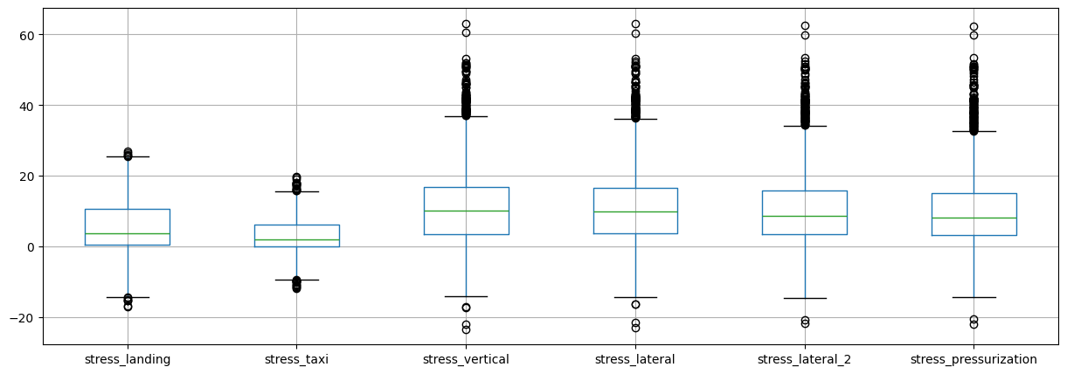
Stress Distribution Overview

Slide 15
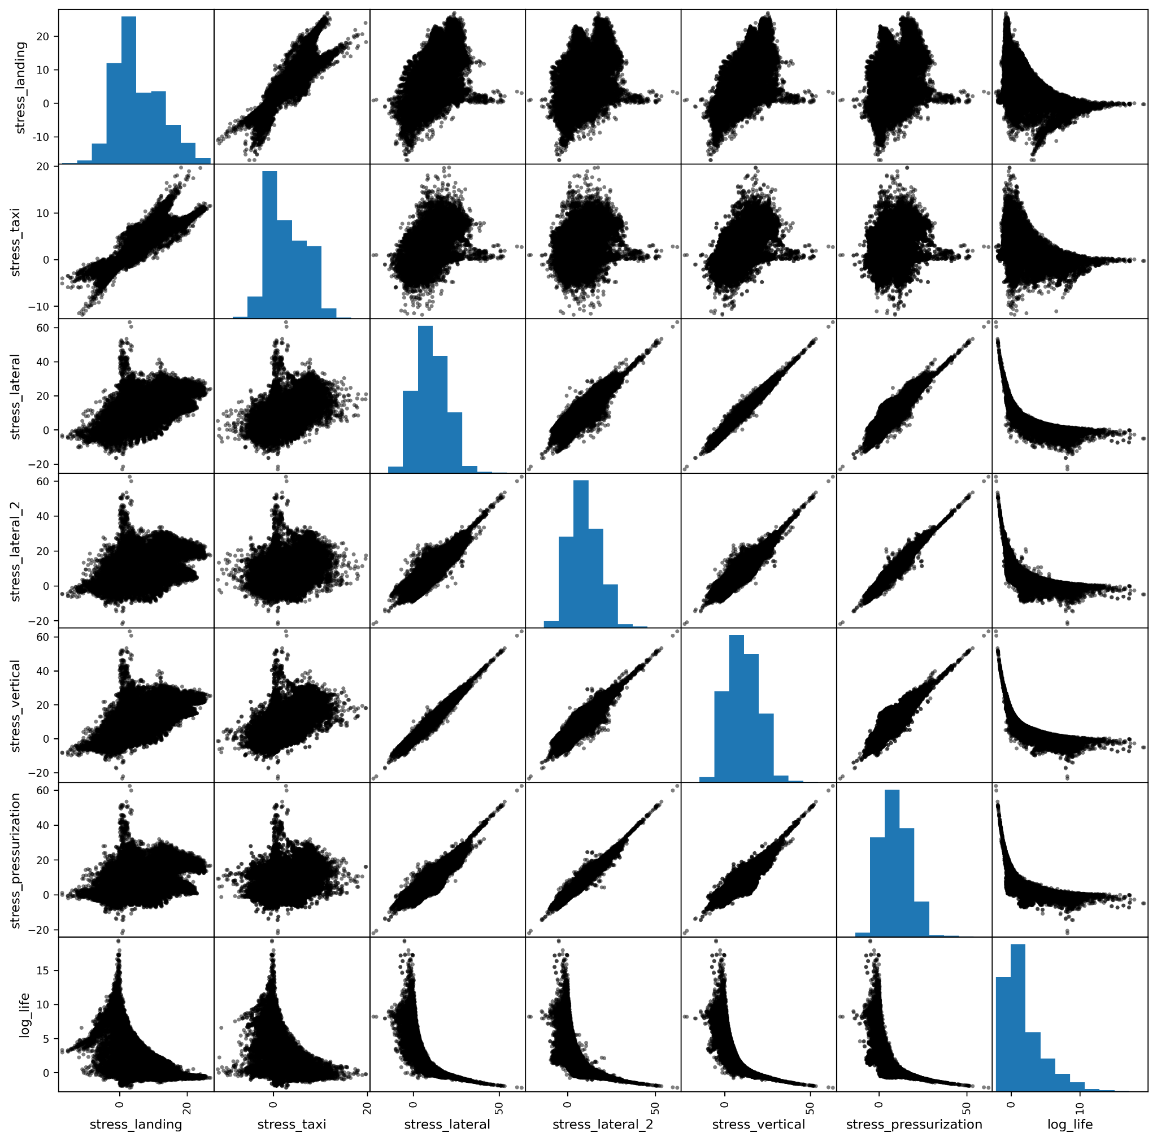
Relationships Between attributes

Slide 16
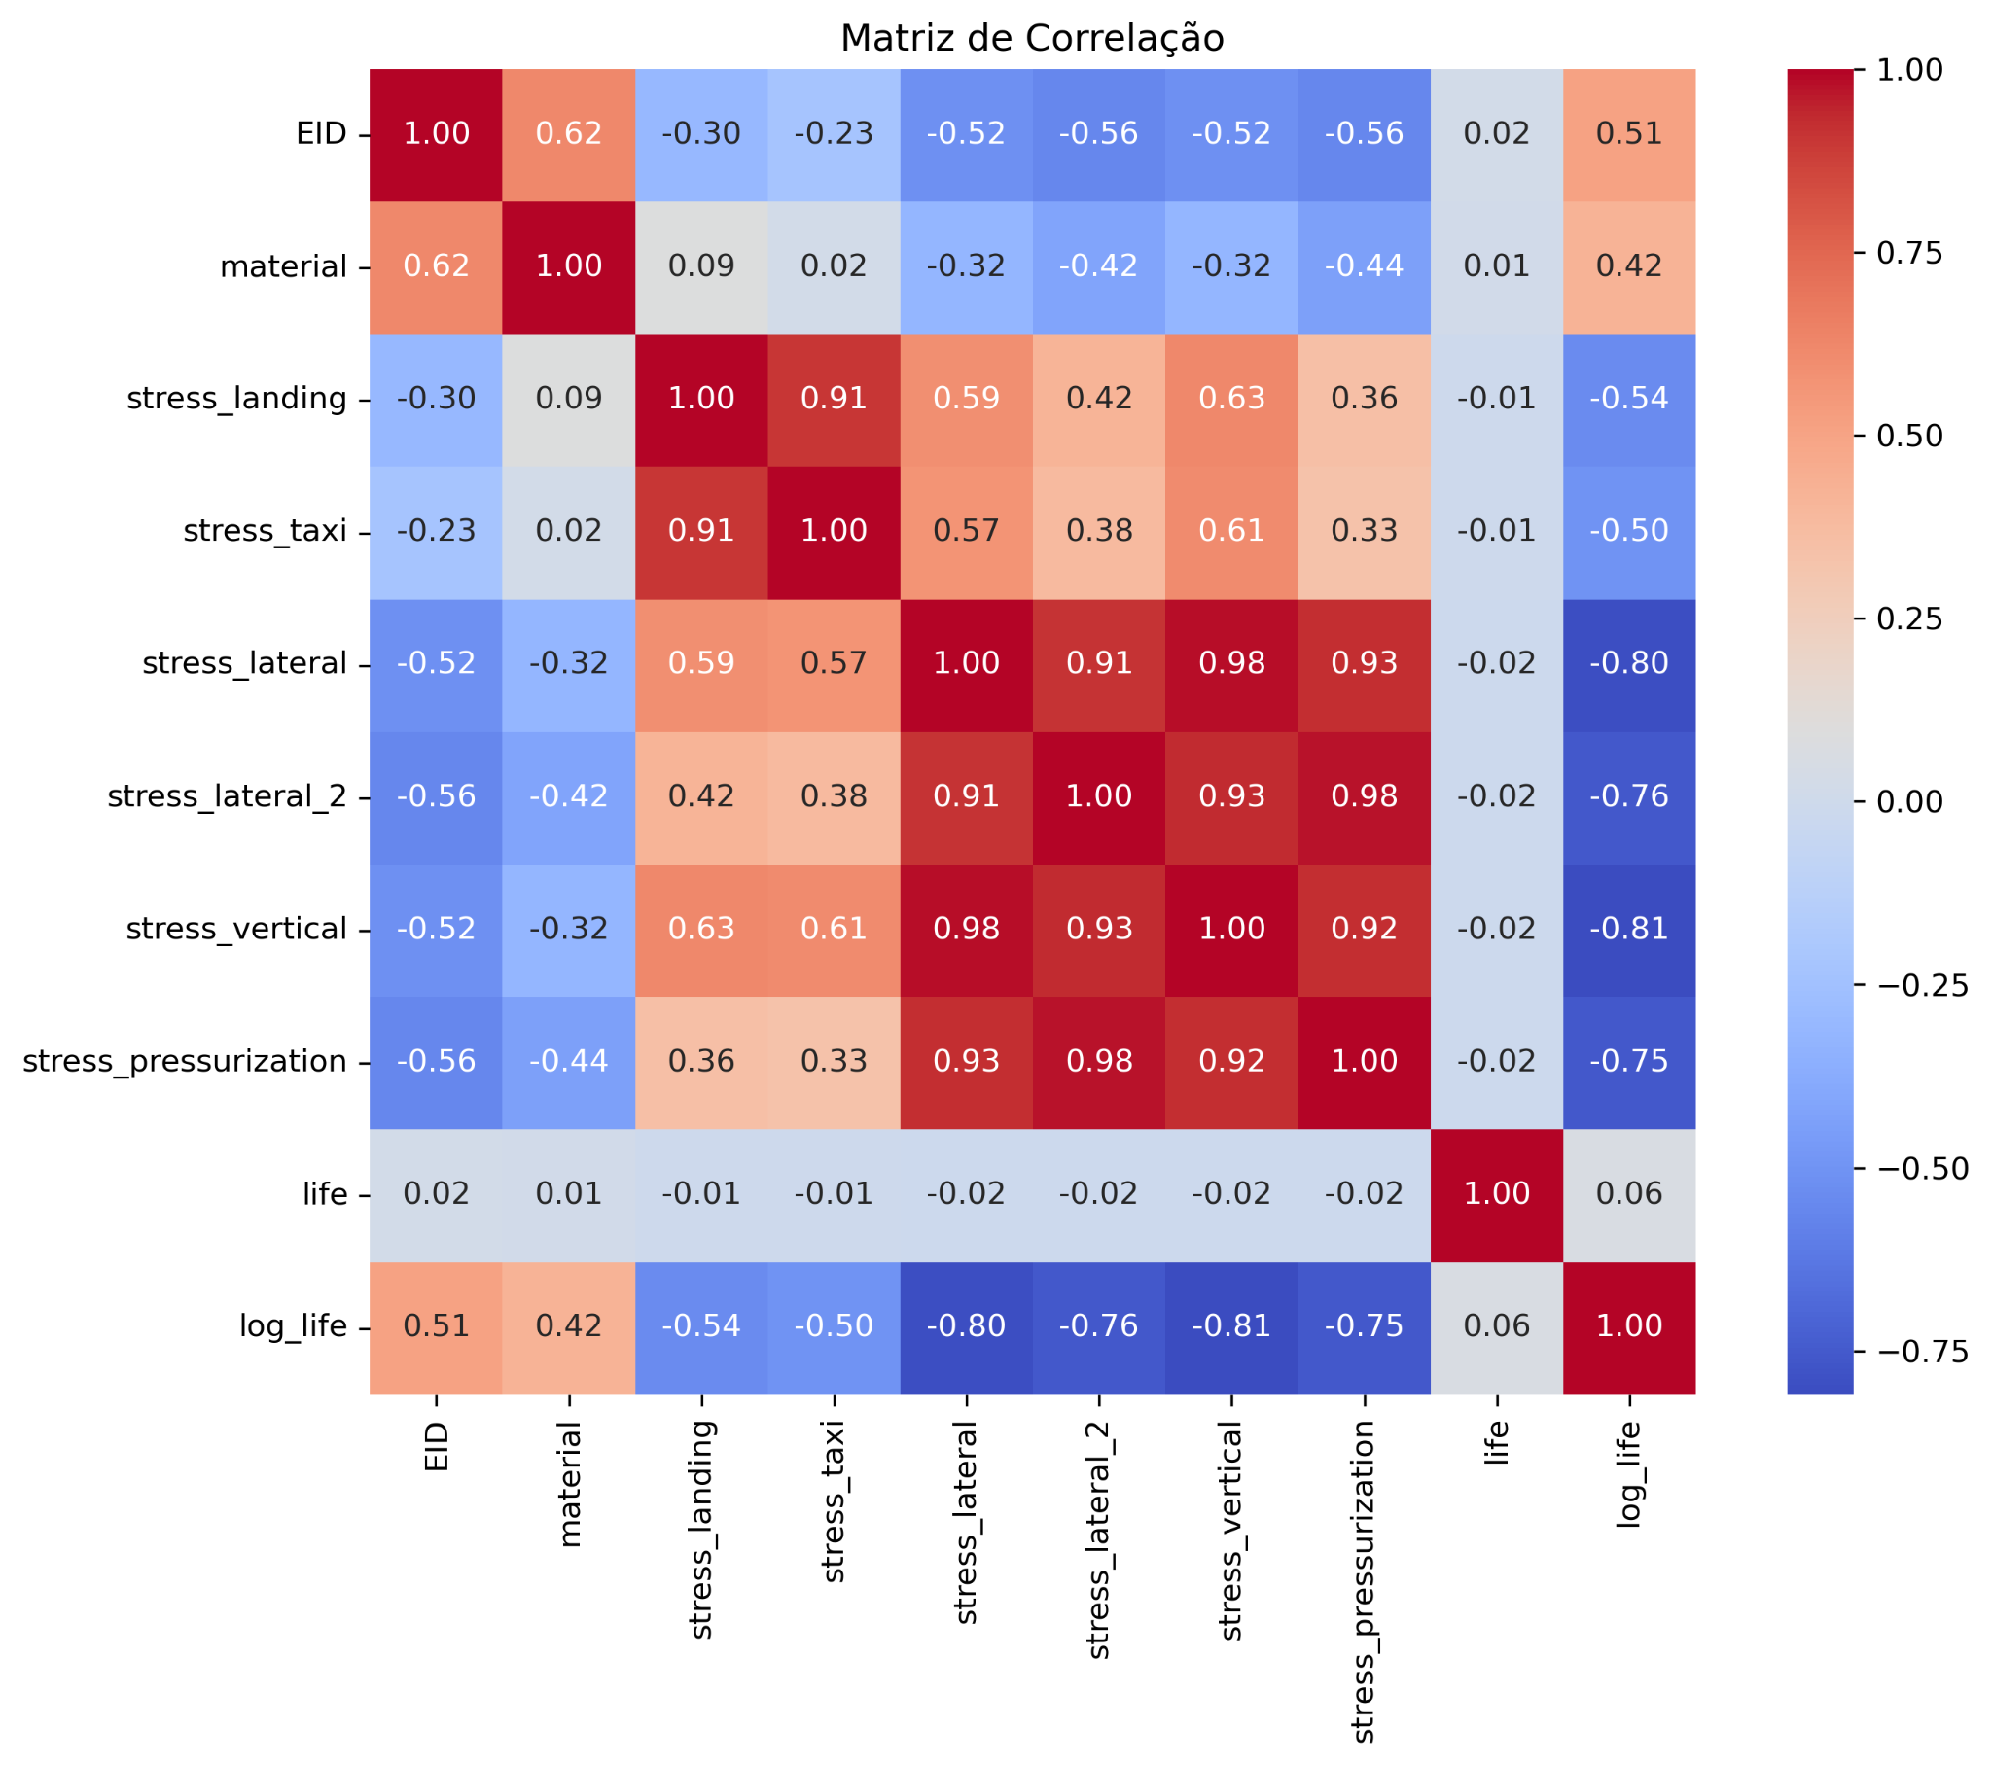
Relationships Between attributes

Slide 17
Data preprocessing
Feature Removal:
EID: identifier column
type: constant value
life: target variable
Categorical Feature:
material encoded using One-Hot Encoding
Numerical Features:
stress_landing, stress_taxi, stress_lateral, stress_lateral_2, stress_vertical, stress_pressurization normalized to range [-1, 1] using Min-Max Scaling

Slide 18
Model Training and Validation
Objective: Evaluate model performance and tune hyperparameters
Tested algorithms:
k-Nearest Neighbors (kNN)
Decision Tree
Support Vector Regressor (SVR) with RBF kernel
Random Forest
Multi-layer Perceptron (MLP) Neural Network
Applied 10-fold cross-validation (KFold) to ensure robust model evaluation
Used GridSearchCV with 3 folds for hyperparameter tuning
Performance metric: Mean Squared Error (MSE), with a custom scoring function to maximize (negative MSE).

Slide 19
Model Training and Validation
Objective: Evaluate model performance and tune hyperparameters
Tested algorithms:
k-Nearest Neighbors (kNN)
Decision Tree
Support Vector Regressor (SVR) with RBF kernel
Random Forest
Multi-layer Perceptron (MLP) Neural Network
Applied 10-fold cross-validation (KFold) to ensure robust model evaluation
Used GridSearchCV with 3 folds for hyperparameter tuning
Performance metric: Mean Squared Error (MSE), with a custom scoring function to maximize (negative MSE).

Slide 20
03
RESULTS
Evaluation, Model Selection and Improvements

Slide 21
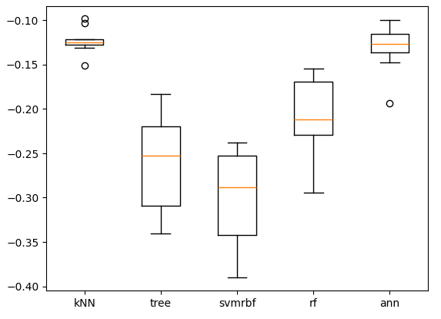
EVALUATION
score
Describe interesting insights about the graph

Slide 22
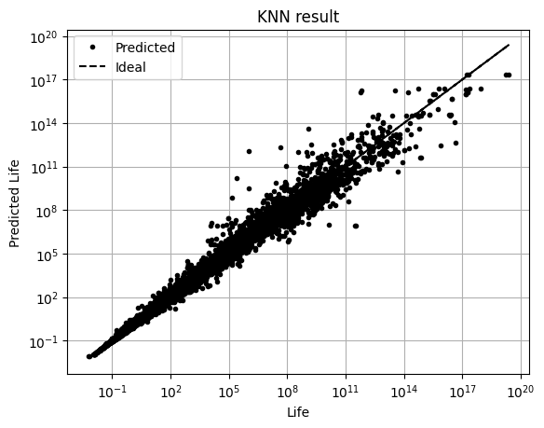
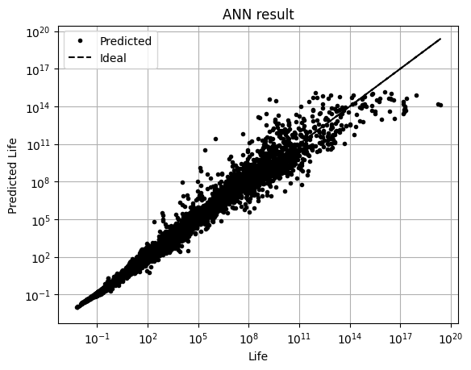
model selection
Describe differences

Slide 23
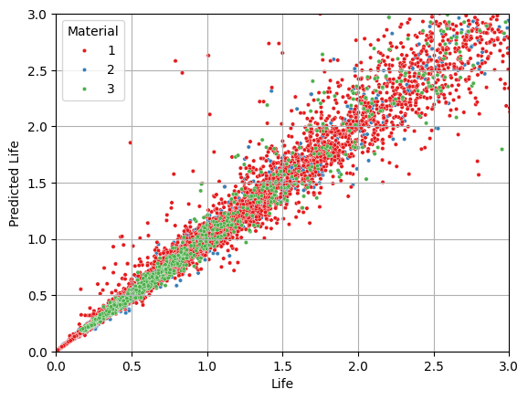
model selection
Describe interesting insights about the graph

Slide 24
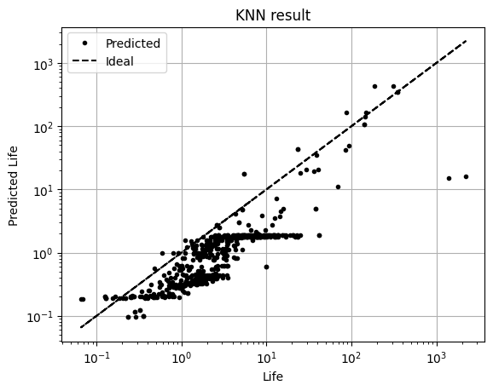
in-production simulation
It can be observed that the majority of the predicted lives fall below the ideal line, indicating that the model is conservative compared to the original one.
This behavior may be related to the distribution of the target variable used during training, which is right-skewed

Slide 25
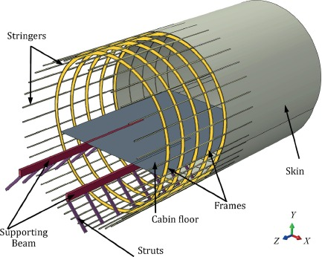
improvements
Use numerical material properties obtained from tests, instead of treating them as categorical attributes;
Acquire additional data that covers the entire aircraft structure;
Develop dedicated models for each material or component type

Slide 26
04
conclusions
Final Remarks

Slide 27
conclusions
KNN algorithm demonstrated good performance → simplicity and ease of interpretability;
The developed model can be used to better understand similarities across the entire aircraft structure, helping to avoid recurrent mistakes and to make better use of lessons learned from previous experience.
Potential improvements can be pursued during the aircraft development phase, using data generated from the various structural analyses conducted by engineers throughout the design cycle;
As new data becomes available, additional training can be performed using the developed methodology, which will likely lead to improved model performance.

Slide 28


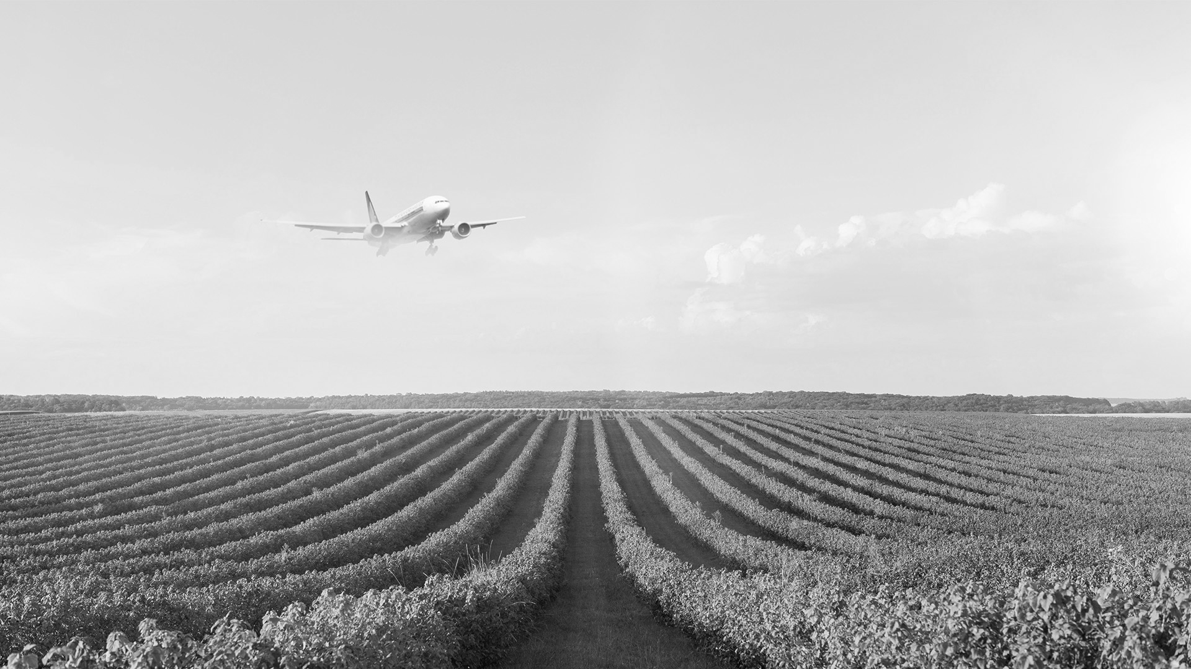
thank you!

Slide 29
AWESOME WORDS

Slide 30
Flight Crew Board
 | Team A | Team B | Team C | Team D | Team E
Mercury | XX | XX | XX | XX | XX
Mars | XX | XX | XX | XX | XX
Saturn | XX | XX | XX | XX | XX
Venus | XX | XX | XX | XX | XX
Jupiter | XX | XX | XX | XX | XX
Earth | XX | XX | XX | XX | XX

Slide 31
parts of an airplane
Saturn
Saturn has rings
Venus
Venus is very hot
Jupiter
Jupiter is a gas giant
Neptune
Neptune is big

Slide 32

COMPUTER MOCKUP
You can replace the image on the screen with your own work. Just right-click on it and select “Replace image”

Slide 33
THANKS!
DO YOU HAVE ANY QUESTIONS?
youremail@freepik.com
+34 654 321 432
yourwebsite.com
Please keep this slide for attribution

Slide 34
RESOURCEs
Did you like the resources in this template? Get them for free at our other websites:
VECTORS
Flat travel background
PHOTOS
Landscape with plane flying in the sky
Hand holding airplane figurine with copy space
Front view smiley woman at work
Front view smiley man holding coffee cup

